Slide 1

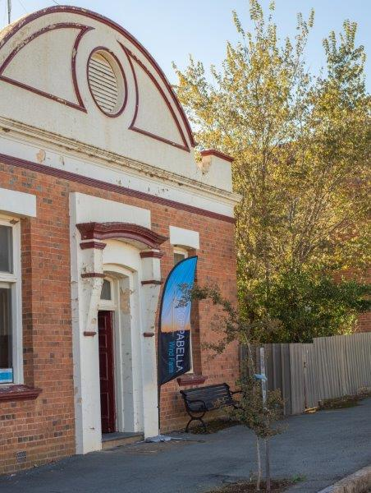

COPPABELLA
WIND FARM
Project Update for CCC Members
27 July 2023

Slide 2
Contents
Community Engagement Update
Project Update
Planning Update

Slide 3
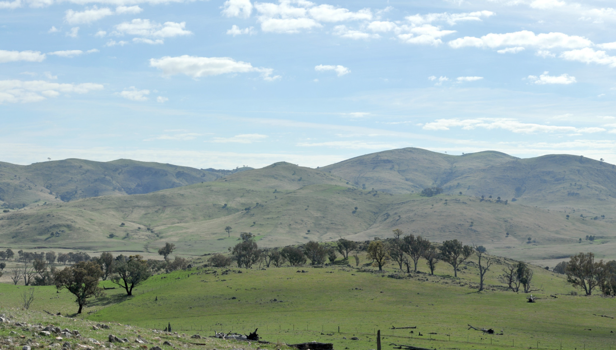
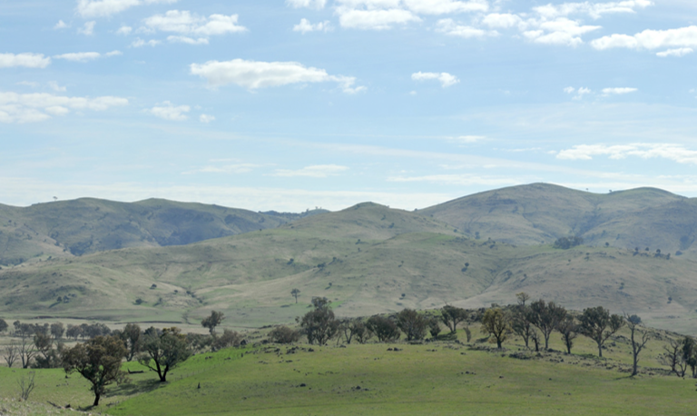
Community Engagement Update

Slide 4
Community Engagement Update
The project team is working to re-open the Binalong Information Centre.
Alison will be present on Mondays 9 - 11am and Thursdays 9am - 12noon
As the project gets closer to construction, Goldwind Australia is keen to continue to support local communities where practical.
Sponsorship Fund continues to operate. Be in touch with Alison if you have any sponsorships ideas or proposals. We are currently exploring options to support the Harden Kite Festival and Yass Irish and Celtic Music Festival.
Project Contact Points
General Information hotline (free call where you leave a messages and Alison will get back to you) | 1800 884 689
Email | info@coppabellawindfarm.com
Website | www.coppabellawindfarm.com
Ben’s direct phone number | 0400 882 095
Alison’s direct phone number | 0401 472 691

Slide 5
Project Update

Slide 6
Project Update – key elements
Progressing internal Goldwind approvals
Firm Pricing for Construction Contracts
Funding arrangements
Finalising Coppabella program
Planning Approvals (State, Federal, Crown):
Environment Protection Licence (for Construction Activities)
Compliance planning activities
Grid Connection Agreement
Connection Application was lodged Feb 2023
Transgrid re-tendering 9R0/99M line upgrade works to selected contractors
Offer to Connect anticipated 4Q23
Land Agreements
Transgrid access arrangements – maintain grid connection
Neighbour Agreements

Slide 7

Project Timeline to 1Q24
Key Dates
Q4 2023
GW Approvals
Planning
Compliance / plans
Early Works
Public Roads Upgrade Works
Grid Works 132kV
Transgrid – Offer To Connect
Q1 2024
Main Notice to Proceed (NTP)
Electrical BOP
Civils BOP
Turbine Supply & Install

Slide 8
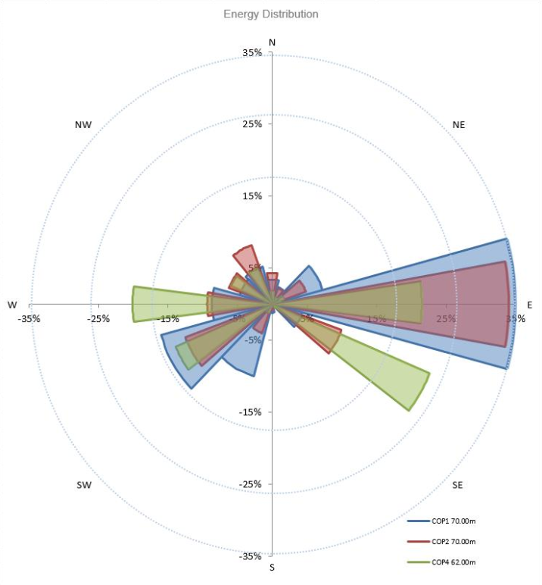
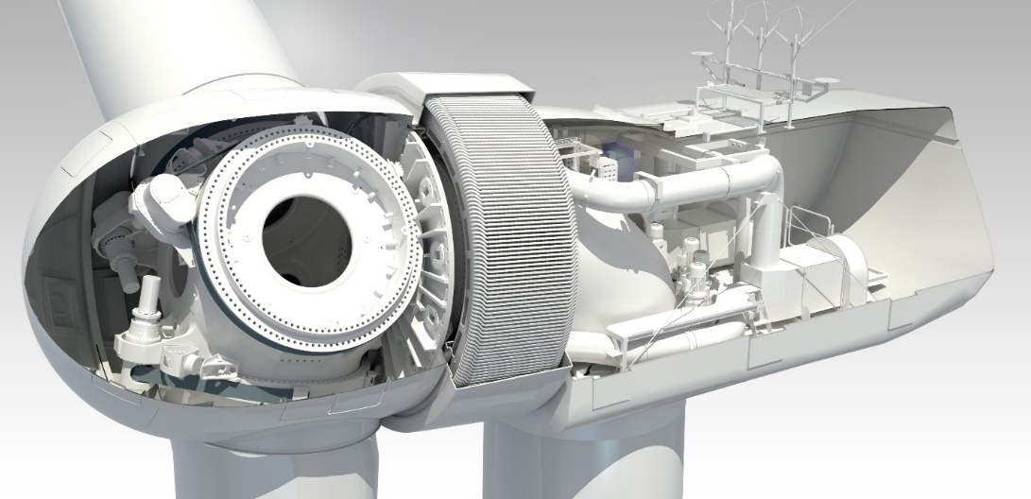
Energy Yield & Layout
Energy Assessment - Key Stats
7.5m/s (27 km/h):
Average wind speed at hub height across the site
6.5-8.5m/s across wind turbine locations
Strong wind resource for NSW
GW4.2 Wind Turbine
The GW136/4.2MW is being proposed for the site:
Permanent magnet direct drive design
No high-speed gearbox
High efficiency
IEC Class IIA wind turbine
100m hub height, 171m tip height

Slide 9
Planning Update

Slide 10
Planning Update
Ongoing Update and Finalisation of Project Documentation
Biodiversity Offsetting Requirements
Ongoing consultation with NSW Biodiversity Conservation Division (BCD) of the Department of Planning & Environment to finalise the biodiversity credit conversion to the new Biodiversity Assessment Method. Vegetation remapping completed (Sch.3, C.19a) with BCD.
Biodiversity Management Plan (BMP)
Final draft prepared for discussion with BCD & DPE
Other Management Plans
Review previously approved management plans and update (where required)
Bird Bat Management Plan started
Progressing Offset arrangements
Environment Protection Licence (EPL)
Application prepared in consultation with BoP tenderers. To be lodged closer to NTP.
Other
Whitefields Road – review of design and defining need for minor vegetation clearing works (consistent with consent allowances and Whitefields Roadside Vegetation Management and Landscaping Plan)
Planning for Project is looking to minimise removal of the allowed clearance of Superb Parrot habitat
Reviewing & re-submission of Water Supply Works approvals for test bores. Production bore timing of use under update.

Slide 11
Q & A

Slide 12
Outstanding Items from CCC #16
Questions Taken on Notice at the previous CCC Meeting:
Norway began studies in 2021 of water contamination (drinking, streams and ocean) in proximity to wind turbines from chemical sheds primarily from blades with items such as Bisphenol A. Contributing to micro plastics in the environment. Are Coppabella hosts aware that there is Bisphenol A used in construction of wind turbine blades?
Bisphenol A (BPA) is a standard organic synthetic compound used to manufacture plastics and epoxy resin. Goldwind uses epoxy resin to manufacture its turbine blades. At this stage Goldwind is not aware of residual BPA being present on completion of epoxy resin formulation.
How much SF6 (Sulphur Hexafluoride) will be used on the Coppabella Project?
TransGrid have responded that SF6 is often utilised in high voltage circuit breakers in the industry, but that they are also working with suppliers to explore equipment options that do not utilise SF6. Thus, it is not known at this time whether the new infrastructure at the Yass Substation will utilise SF6 or not.
In the industry, typical amounts of SF6 utilised in high voltage circuit breakers are:
132kV: ~26-30kg per circuit breaker
330kV: ~40-80kg per circuit breaker
Depending on configuration a maximum of 11.5kg of SF6 is used as an electrical insulator within the interrupter of Ring Main Units (RMU). Each turbine has a single RMU for generation to flow into the wind farm's ring main. Goldwind Australia has requested whether there are plans to use an alternative charging gas.

Slide 13
Outstanding Items from CCC #16
Questions Taken on Notice at the previous CCC Meeting:
In NSW, who is responsible for checking the integrity of each process of laying down wind turbine footings? That is just like the construction of a house the reinforcing mesh for footings has to be inspected, then the actual concrete footing is this procedure followed in NSW for wind turbines in light of the lack of integrity and checks of wind turbine footing by the developer GPG as recently (December 2022) happened in Victoria with Berrybank Stage Or do we see a repeat of Gullen Range debacle by Goldwind self-checking on micro sighting and eventual NSW DPIE “rubber stamping” of the less than microsited towers?
An independent Certifier is engaged to assure wind turbines are designed and constructed in accordance with the relevant standards, including the structural design requirements of IEC 61400-1. This includes wind turbine footing design that is covered by a construction certificate together with testing of the concreting during formation of the footing.
In light of 5th January 2023 narcel fire in nearby Cullerin wind turbine who is ultimately responsible for any large-scale fire instigated by such a turbine fire? Host, turbine development developer or current wind turbine operator? Capital 17th January 2017-Class Action? Taralga 17th January 2018-aerial water bombardment stopped due to lack of visibility?
Public liability insurance is in place that covers the host landowners’ properties in accordance with their lease terms, it is our understanding this cover would extend to damage in the unlikely event of fire caused by a turbine.
Will the Goldwind GW136/4.2MW turbines come with a self-suppression system for internal fire? What will be the periodic testing time for this system if installed?
All Goldwind turbines in Australia are configured with fire detection/alarm systems rather than fire suppression systems. The alarm system is connected to the SCADA system. As part of the suite of standard site HSEQ management plans, there will be a site-specific management plan covering fire and other emergencies. Please note that, to date, no fires have occurred at a Goldwind wind farm. The Goldwind 4.2MW turbine does not have a gearbox or transformer in the nacelle, making the risk of nacelle fire significantly lower than other turbine models
Will the Goldwind GW136/4.2MW turbines come with a self-suppression system for internal fire? What will be the periodic testing time for this system if installed?
Implications of Goldwind impacting the habitat of the Gang Gang Cockatoo? And the Impacts on the Bogong Moth?

Slide 14
Outstanding Items from CCC #16
Questions Taken on Notice at the previous CCC Meeting:
Will Goldwind hold training courses for all RFS Brigades surrounding the Coppabella Range in management of a wind turbine fire?
It is usual practice for local emergency groups (including RFS) to be invited to site during wind farm operations. This familiarizes them with the site and build relationships with the on-site service team. Specifically at Coppabella, we are working with Harden Rural Fire Control and will arrange a presentation regarding general information surrounding the Project. We understand Harden Rural Fire Control are currently developing a standard operating procedure and we are happy to contribute where possible.
CWF is committed to assisting the local community where possible and would be happy to support with donations to the RFS where requested.
What are the implications of Goldwind impacting the habitat of the Gang Gang Cockatoo?
This was assessed in the Biodiversity Assessment as part of the EIS. The Biodiversity Assessment concluded that the development has a low habitat removal risk for the Gang Gang Cockatoo. The assessment recommended this as a target species for operational bird and bat monitoring. This will be included in the Bird and Bat Adaptive Management Plan which will be prepared for the development.
The Coppabella Wind Farm is an approved project (SSD-6698) which has involved extensive environmental studies throughout the process. Potential impacts to threatened bird species including the Gang Gang Cockatoo have been addressed as part of these assessments.
The conditions of approval require the project to implement all reasonable and feasible measures to minimise impacts on threatened bird and bat populations. These conditions will ensure to minimise the approved clearing of hollow-bearing trees, native vegetation and key habitat within the approved disturbance footprint. This will be addressed in the project Biodiversity Management Plan. Further, a Bird and Bat Adaptive Management Plan is also required for the Project. Both these plans are in the process of being finalised in consultation with the NSW Biodiversity Conservation Service Division of the DPE.

Slide 15
Outstanding Items from CCC #16
Questions Taken on Notice at the previous CCC Meeting:
What is the impact of Coppabella on the Bogong Moth?
This species was not identified in the Biodiversity Assessment in the EIS or any supplementary Biodiversity Assessments. This species is found across much of south-eastern Australia and breed in hot, dry areas before migrating to alpine caves in summer. There is a potential for this species to be present in the region - however this has not been identified in any assessments undertaken to date for Coppabella Wind Farm.
Although the Bogong Moth is not expected to be present, the condition in the planning permit below will minimise potential impacts to Bogong Moths while maintaining the minimum safety and security requirements for the Project.
The planning consent includes Condition 4 of Schedule 3, that the Project must:
a) Implement all reasonable and feasible measures to minimise the off-site lighting impacts of the development;
b) Ensure that any aviation hazard lighting installed utilises an aircraft detection lighting system, unless otherwise agreed by CASA;
c) Ensures that all external lighting associated with the development (apart from any aviation hazard lighting):
• Is installed as low intensity lighting (except where required for safety or emergency purposes);
• Does not shine above the horizontal;
• Uses best management practice for bat deterrence; and
• Complies with Australian Standard AS4282 (INT) 1997 – Control of Obtrusive Effects of Outdoor Lighting, or its latest version.
Further investigation: Have you advised the landholders that disintegration of blades could occur and cause fibres to be distributed around the land and end up in sheep wool?
During regular life cycling, blade deterioration is not known to distribute any significant level of fibre into the surrounding environment.
We conduct regular blade reviews to assess blade condition and make repairs where required.

Slide 16
THANKYOU
GOLDWIND AUSTRALIA PTY LTD

