Slide 1

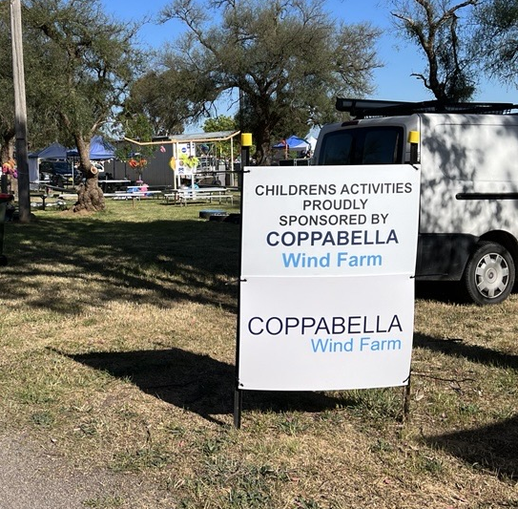

COPPABELLA
WIND FARM
Project Update for CCC Members
19 March 2026

Slide 2

Acknowledgement of Country​
We acknowledge the Traditional Custodians of the Land where our project is located.
We pay our respects to Elders past, present and emerging, and recognise their enduring cultural, spiritual, and historical connections.

Slide 3
Contents
Community Engagement Update
  Project Update
  Planning Update
  Grid Update

Slide 4
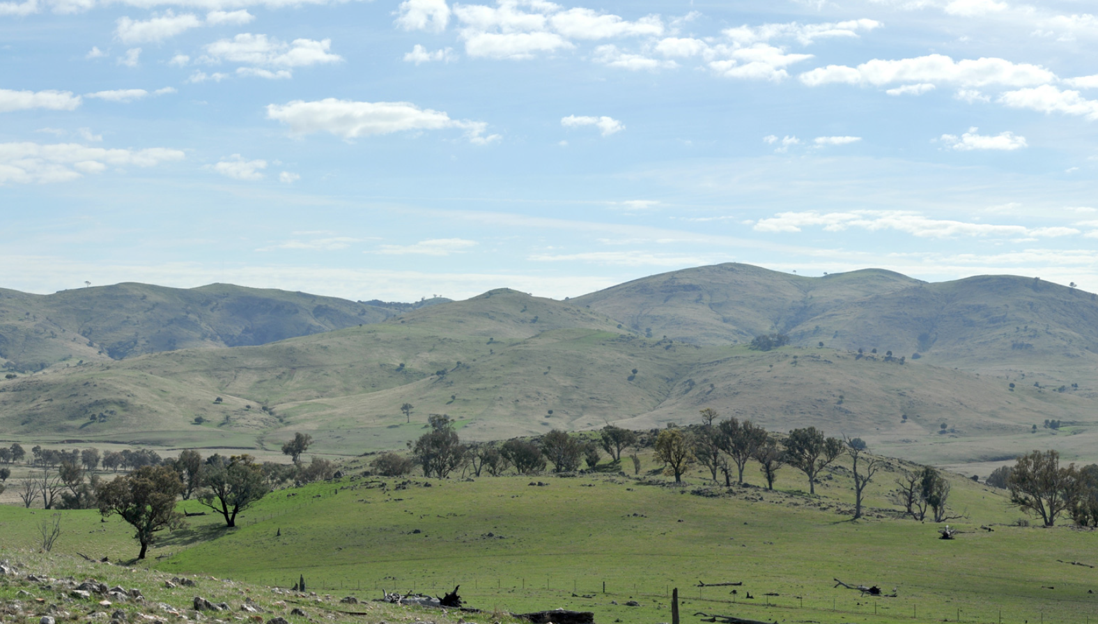
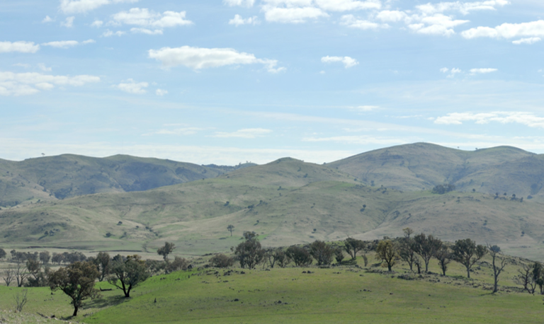
Community Engagement Update

Slide 5
Community Engagement Update
The Binalong Information Centre is open
  Alison is available at Binalong on Mondays 12:30 – 2:30pm and Thursdays 9am – 12pm.
  The Community Partnership Program continues.
  Alison and Paul met with the Onerwal LALC and Buru Ngunawal Aboriginal Corp to discuss heritage protection during upcoming construction works.
  Coppabella Website is continuously updated. This includes new information about LTESA reporting done on a quarterly basis.
The Information Centre is open to provide information about the development and operation of Coppabella Wind Farm.

Slide 6
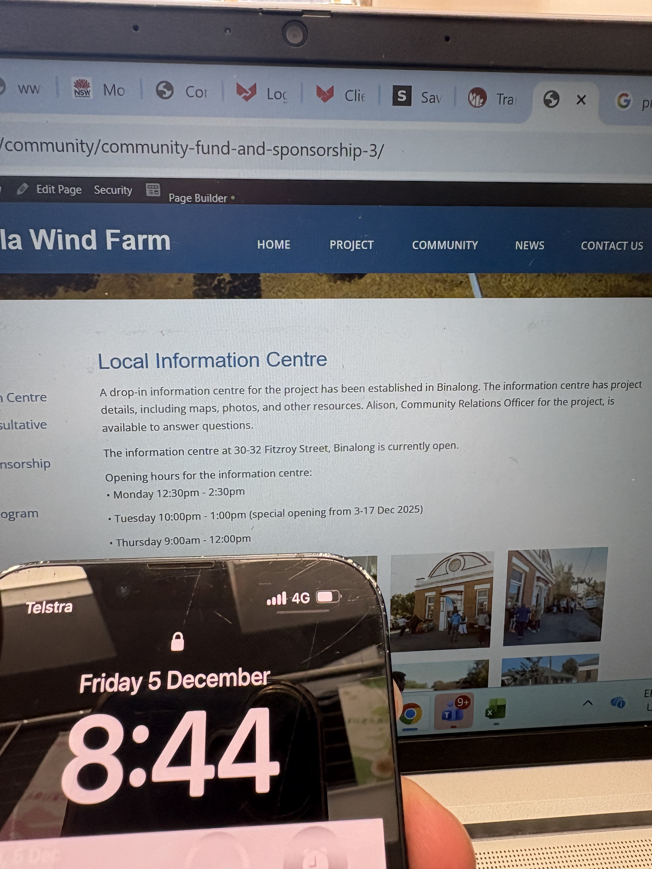
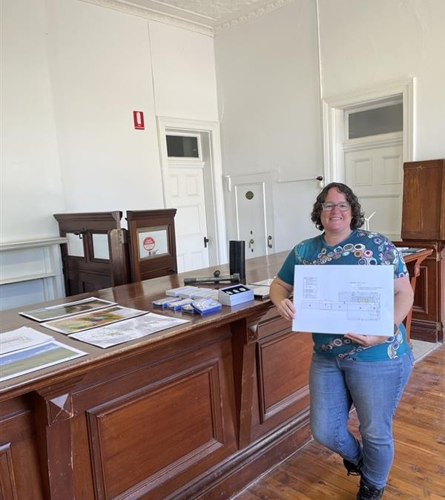
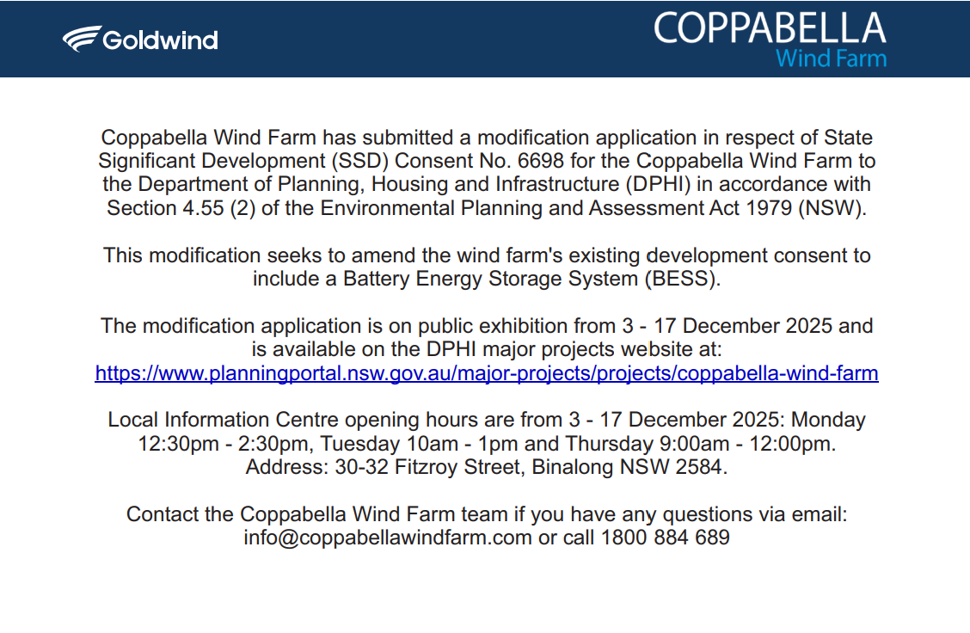
  BESS Modification Engagement
  Stakeholder meetings
  Web Updates
  Info Centre open extra day
  Phone
  Email
  Newspaper
  Flyer drop in Binalong and Bookham

Slide 7
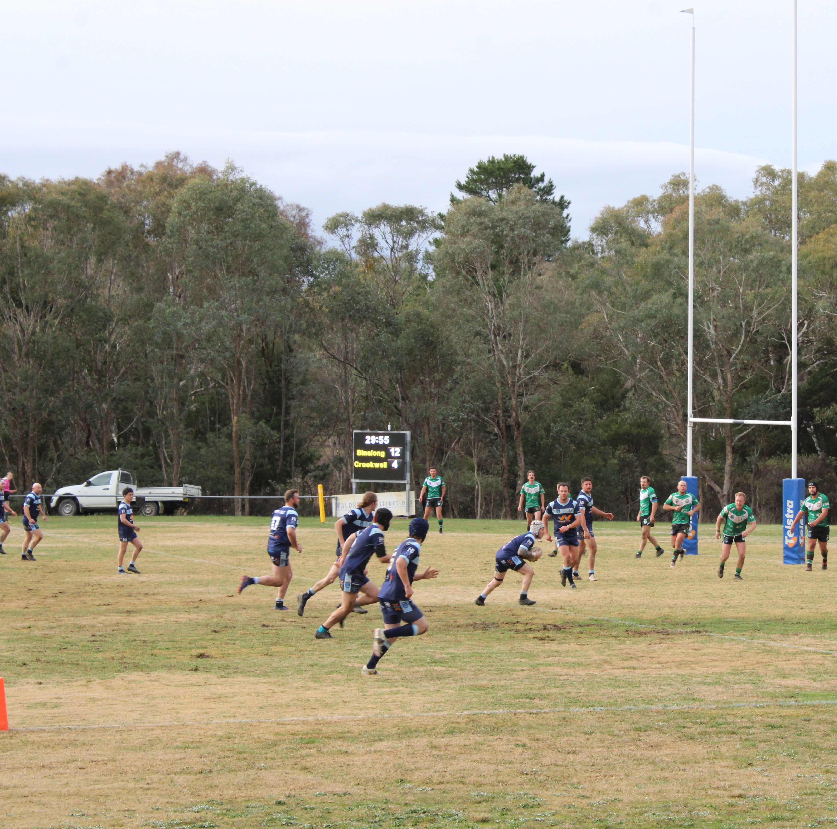
Community Partnerships
Our commitment to the community
LTESA commitment prior operation $35,000+/year for local projects + more in jobs and training to follow
Operating Agreements between Yass Valley and Hilltops Councils Community Enhancement Fund: $172.5K/year, Supplementary fund of an additional $100k
Coppabella Wind Farm is open for community sponsorship and partnership applications.
Previously sponsored Binalong Brahmans Football Team
Notes:
Speak about the sponsorships in more detail ie. $8000 to Bookham community association to support a variety of management and design initiatives they need help to complete ie Bookham Memorial Hall.
BESS Public Exhibition

Slide 8
Community Engagement
Project Contact Points
General Information hotline (free call where you leave a message and Alison will call you back) | 1800 884 689
Email | info@coppabellawindfarm.com
Website | www.coppabellawindfarm.com
Paul’s direct phone number (Stakeholder Engagement Manager) | 0400 004 293
Alison’s direct phone number (Local Community Relations Officer) | 0401 472 691

Slide 9
Project Update

Slide 10
Project Update – key elements
    Progressing internal Goldwind approvals
  Firm Pricing secured for Construction Contracts tendered – eBOP / cBOP – this includes BESS addition
  Construction Funding arrangements progressing
Finalised Coppabella program
  civil, electrical, grid and turbine program components integrated
    Planning Approvals (State, Federal, Crown):
  Modification 2 for BESS Addition – Submissions Report stage
  Satisfying pre-construction conditions and compliance planning activities
  Environment Protection Licence (for Construction Activities)
    Grid Connection Agreement
  Connection Application was lodged Feb 2023
  Offer to Connect (Technical 5.4.3 a & b Letters) was provided 12th Jul 24 and basis of 2026 renewal agreed
  Transgrid has completed price-firming activities on grid works with selected contractors
  OA (Ordinance Survey) underway – this is used to pinpoint location for infrastructure to plan how infrastructure fits with the existing grid mapping for grid infrastructure
    Land Agreements
  Transgrid access arrangements – connect to grid (finalised)
  Neighbour Agreements
Notes:
A Static Synchronous Compensator (STATCOM) is a fast-acting, power-electronics-based device (FACTS) used in electrical networks to provide, or absorb, reactive power to regulate voltage, enhance stability, and improve power quality. By using a voltage source converter (VSC), it provides instant reactive compensation to prevent voltage collapse, acting faster than traditional SVCs.

Slide 11
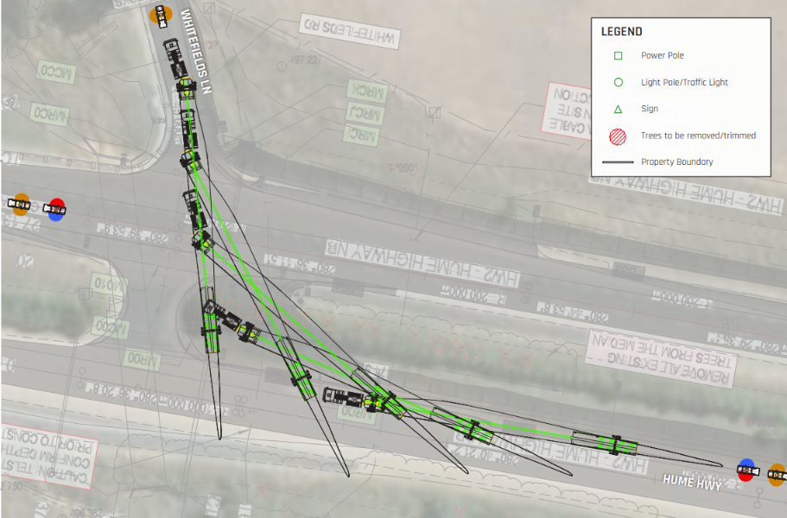
Preparing for Construction
– Public roads upgrade work
  Public roads upgrade work will improve access to Whitefields Road and Hume Highway – scheduled for 2Q 2026
  Whitefields Road has environmental protection considerations, to ensure we protect local bird populations. Must adhere to native vegetation clearing approved by DPHI for the project.
  Ongoing liaison with Yass Valley Council and Transport for NSW
Notes:
Overview

Slide 12
Planning Update

Slide 13
Planning Update
Ongoing Update and Finalisation of Project Documentation
Biodiversity Offsetting Requirements
  Biodiversity offset credit requirements received in January 2025. This satisfies CoC 19(A) a) and b). Confirmation of this is on Dept of Planning Website. Retirement of credits to be completed within 2 years from the commencement of construction
  Variation to Condition of Approvals
  EPBC 2017/8129 was varied in May 25. Key change was the amendment of approved vegetation clearance limits and reduction in hollow bearing tree removal to reflect the updated mapping.
  Biodiversity Management Plan (BMP)
  Approval from State and Federal agencies has been received. The BMP is now available on the CWF website.
  Other Management Plans
  Approved and any updated management plans are located on CWF website (Heritage, EMS, Superb Parrot Research Plan)
  Current approved TMP is being updated in consultation with TfNSW - around intersection upgrade for Hume Hwy & Whitefields Rd
  Works authorisation deed and Section 138 permits being prepared for road upgrades
  Bird & Bat Management Plan – drafted – required prior to commissioning of turbines
  Whitefields Roadside Vegetation Management and Landscaping Plan – in place. Future updates planned closer to construction and detailed design of Whitefields Road.

Slide 14
Mod 2 Submissions
The Modification 2 submissions were received during public exhibition late last year.
There were a total of 85 submissions made, with most coming from outside the local area (65% > 100 km).
Submissions can be complex. The analysis and responses reflect the diverse topics of the submissions.
-

Slide 15
Submission Categories
-

Slide 16
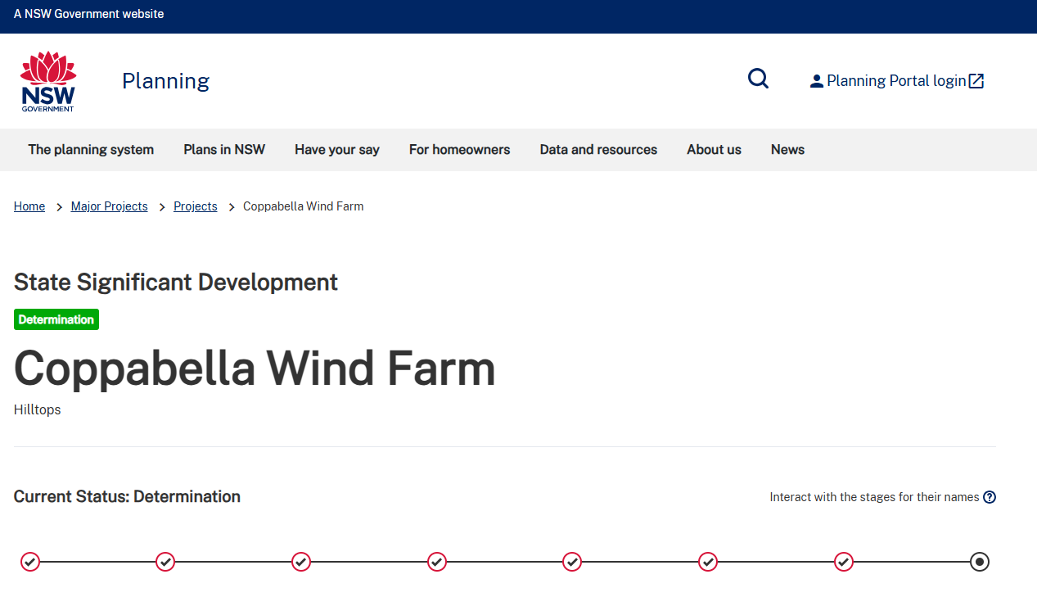
Next steps
Goldwind Australia has submitted a Response to Submissions Report to respond to the diverse topics identified in each of the submissions.
DPHI will align their own assessment of the modification with the topic areas covered in the submissions.
You can view all updates on the
DPHI Major Projects website.

Slide 17
Grid Update

Slide 18
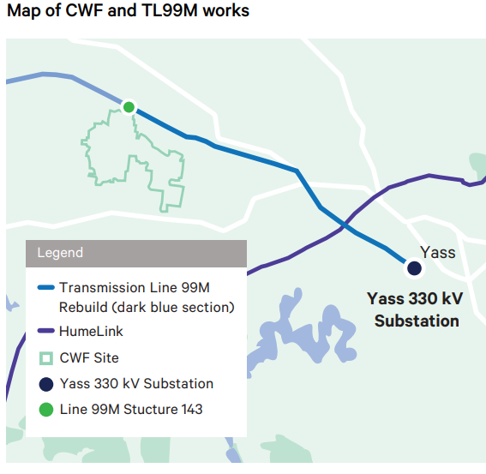
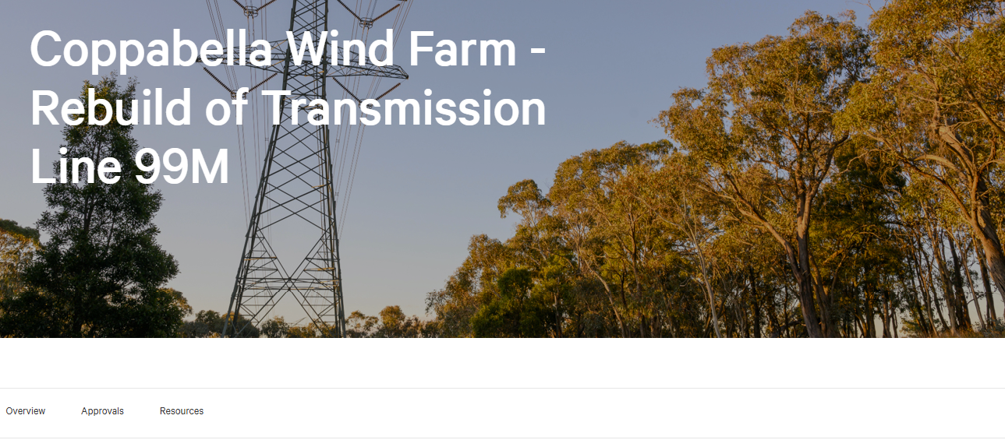
Transgrid works
Reinstallation of the Yass Substation to Murrembateman 39km transmission line called the 99M
Installation of the dedicated 9RO 132kV line from Coppabella Wind Farm to Yass Substation
Stakeholder discussions are being conducted by Transgrid.
Transgrid line upgrade website

Slide 19
Grid
NER 5.3.9 Modification Process for Addition of BESS: Engagement completed with AEMO and Transgrid for inclusion of BESS in project scope.
Stakeholder Discussions: Scope of due diligence power system studies finalised after collaborative discussions with AEMO and Transgrid.
Due diligence power system studies have been completed. These have been provided to AEMO and Transgrid.
Transgrid (& AEMO) are progressing with requested modification approval to include BESS (i.e. 5.3.9 process).
Notes:
The NER 5.3.9 process is a National Electricity Rules change management procedure in Australia for modifying existing generating systems. It requires proponents to engage with the Australian Energy Market Operator (AEMO) and Network Service Providers (NSPs) to assess impacts on system performance and security. The process ensures that altered plants still meet agreed performance standards or that standards are renegotiated.

Slide 20

Delivery Program
Project Activities
Indicative timeline, may change
Initial Works
Transmission Line Works
Transmission: Preliminary designs & procurement specifications
Offsite Road Upgrades
Site Calibration Met Masts
Geotech investigations
Substation Energisation
Site Establishment
Civil Works
Start of turbine access road construction including
Start turbine foundation and hardstand construction
Electrical Works
Site Establishment
Start cable trenching and installation
Start cable terminations and testing
Year 1
Year 2
Year 3
Turbine Deliveries and Installation
Turbine deliveries commence
Turbine installations commence
Turbine Testing and Commissioning
BESS Approvals, Manufacture, Delivery To Site
BESS installation
Start WT Commissioning
NTP – 2Q26 (est)
Energisation - 28 mths
COD - 40 mths
Practical Completion - 43 mths
Full Operations

Slide 21
Q & A

Slide 22
Outstanding Items from CCC #23
Q: Distance of nearest resident to a turbine?
A: 2.65km from the nearest turbine.

Slide 23
Glossary
kV
kiloVolt – a thousand volts, a volt is a measure of electromotive force for power circuits
Lac
LiDAR assisted control
LiDAR
Light detection and ranging
LTESA
Long-Term Energy Service Agreement
NTP
Notice to Proceed
REF
Review of Environmental Factors
RFI
Request for Information – a document that details information, guidance and clarification needs required for specific aspects of a project.
STATCOM
Static Synchronous Compensator – a reactive power regulating device based on the voltage sourced converter (VSC) used to maintain AC system voltages and to enhance the stability of the AC system
TG
Transgrid
WT/WTG
Wind Turbine Generator
AEMO
Australian Energy Market Operator
BCD
Biodiversity Conservation Department
BOP
Balance of Plant
COD
Commercial Operation Date
DCCEEW
(Federal) Department of Climate Change, Energy, the Environment and Water
DPE / DPHI
The changing name of the NSW Department of Planning
(DPE – Department of Planning and Environment,
DPHI – Department of Planning, Housing and Infrastructure)
GW (A)
Goldwind (Australia)
IIA
Wind Class/Turbulence classification per IEC 61400
IEC
International Electroctechnical Commission

Slide 24
THANK YOU
GOLDWIND AUSTRALIA PTY LTD

