Slide 1

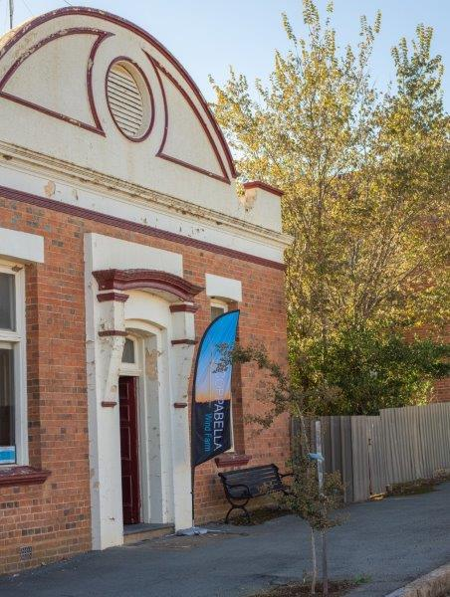

COPPABELLA
WIND FARM
Project Update for CCC Members
11 July 2024

Slide 2
Contents
Community Engagement Update
  Project Update
  Planning Update
  Construction & Operations phases – asset management introduction

Slide 3
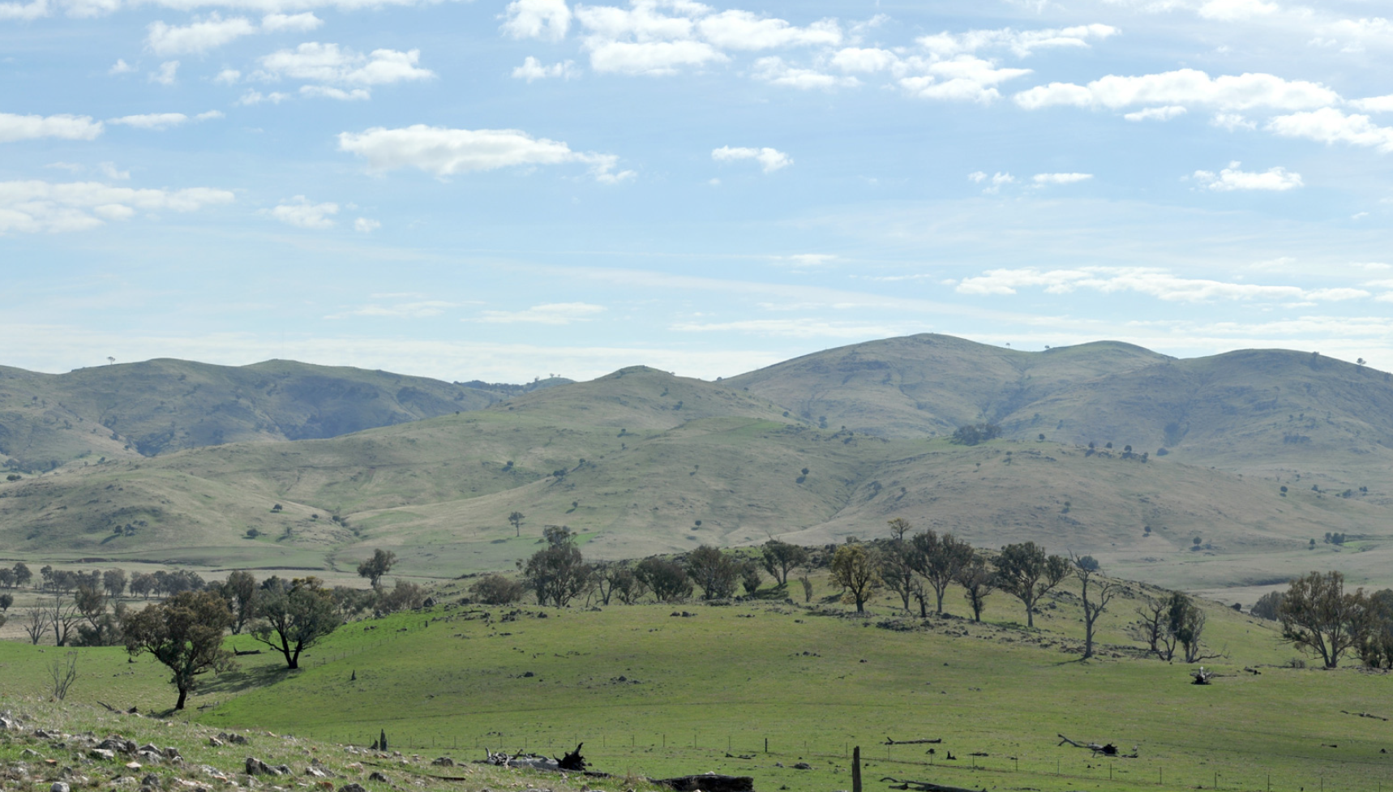
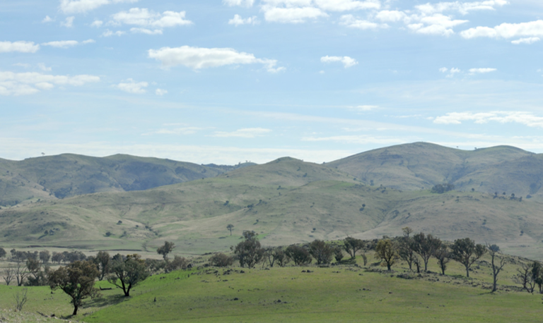
Community Engagement Update

Slide 4
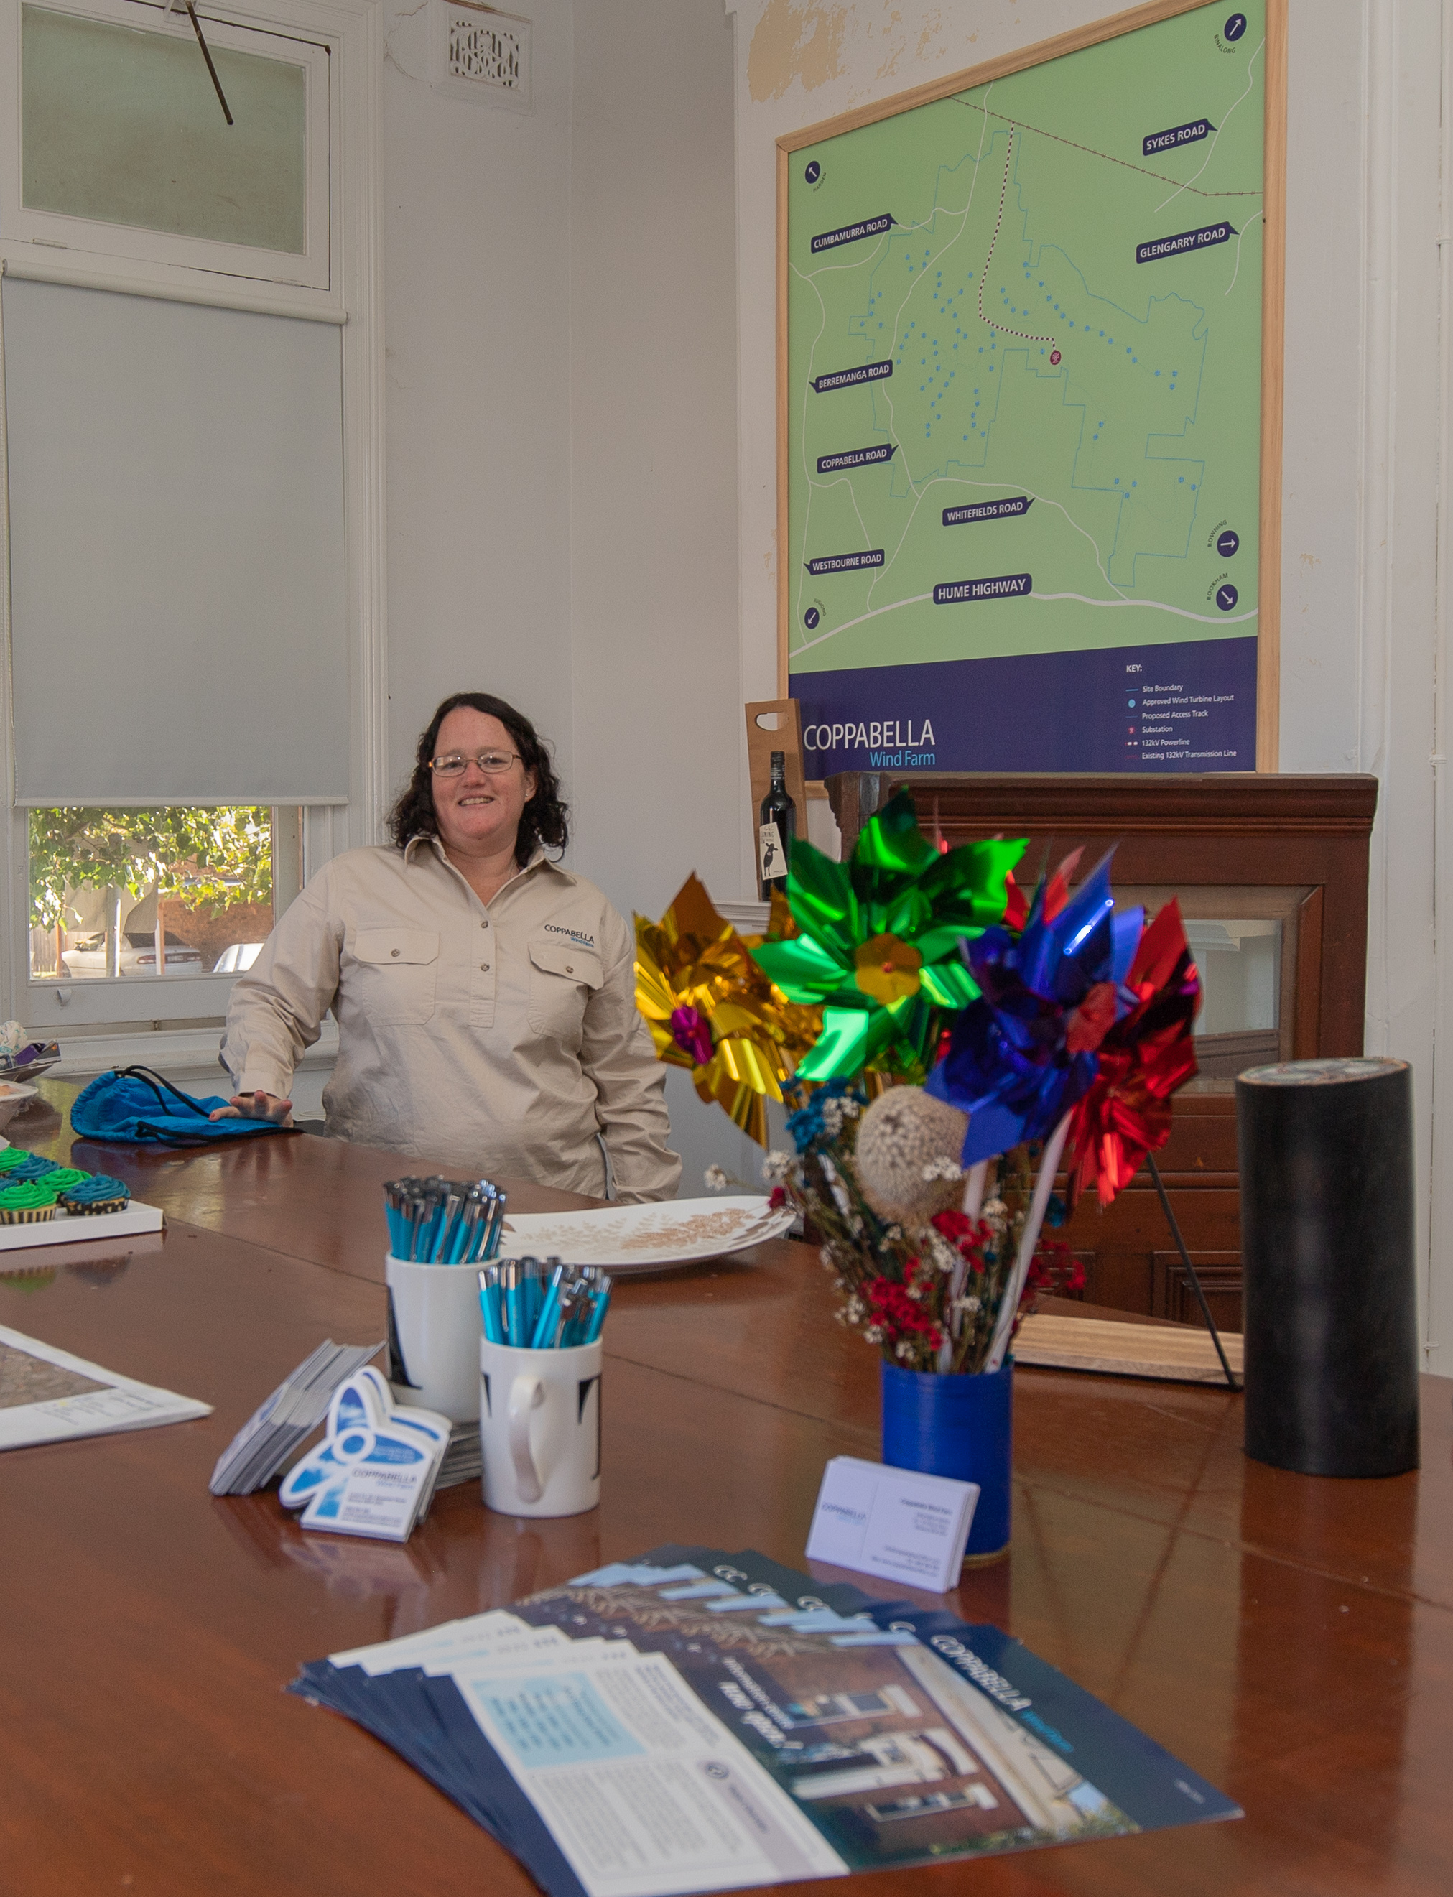
Community Engagement Update
The Binalong Information Centre is open
  Alison is at Binalong on Mondays 12:30 – 2:30pm and Thursdays 9am – 12noon
  Sponsorship began with the Binalong NSW Swimming Club and Binalong Brahmans
  Paul and Alison have met with some local neighbours to re-establish contact
  and provide a project update
  Measure have been taken to attempt contact with disconnected lines
  Winter Newsletter is being distributed
  Coppabella Website is continuously updated. Project updates and news available, as we progress towards construction
As the project gets closer to construction, we will continue to support local communities
Sponsorship Fund continues to operate.
Latest partnerships with the Binalong NSW Swimming Club and the Binalong Brahmans.
Contact Alison or Paul if you have any sponsorships ideas or proposals.

Slide 5

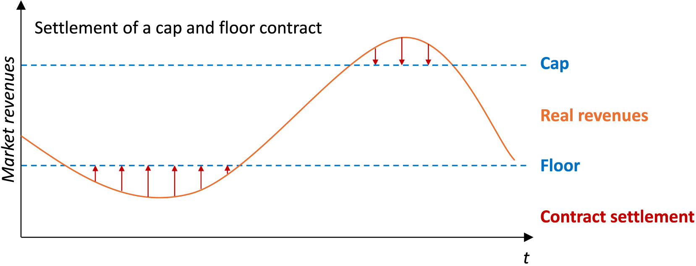
Long-Term Energy Service Agreement (LTESA)
Goldwind Australia partner
What is it?
LTESAs will provide generators with the option to sell their electricity at an agreed minimum fixed price to the market.
This provides additional revenue certainty for investment. Scheme is run by the NSW Government.
The LTESA term is for 20 years to ensure community benefits.

Slide 6
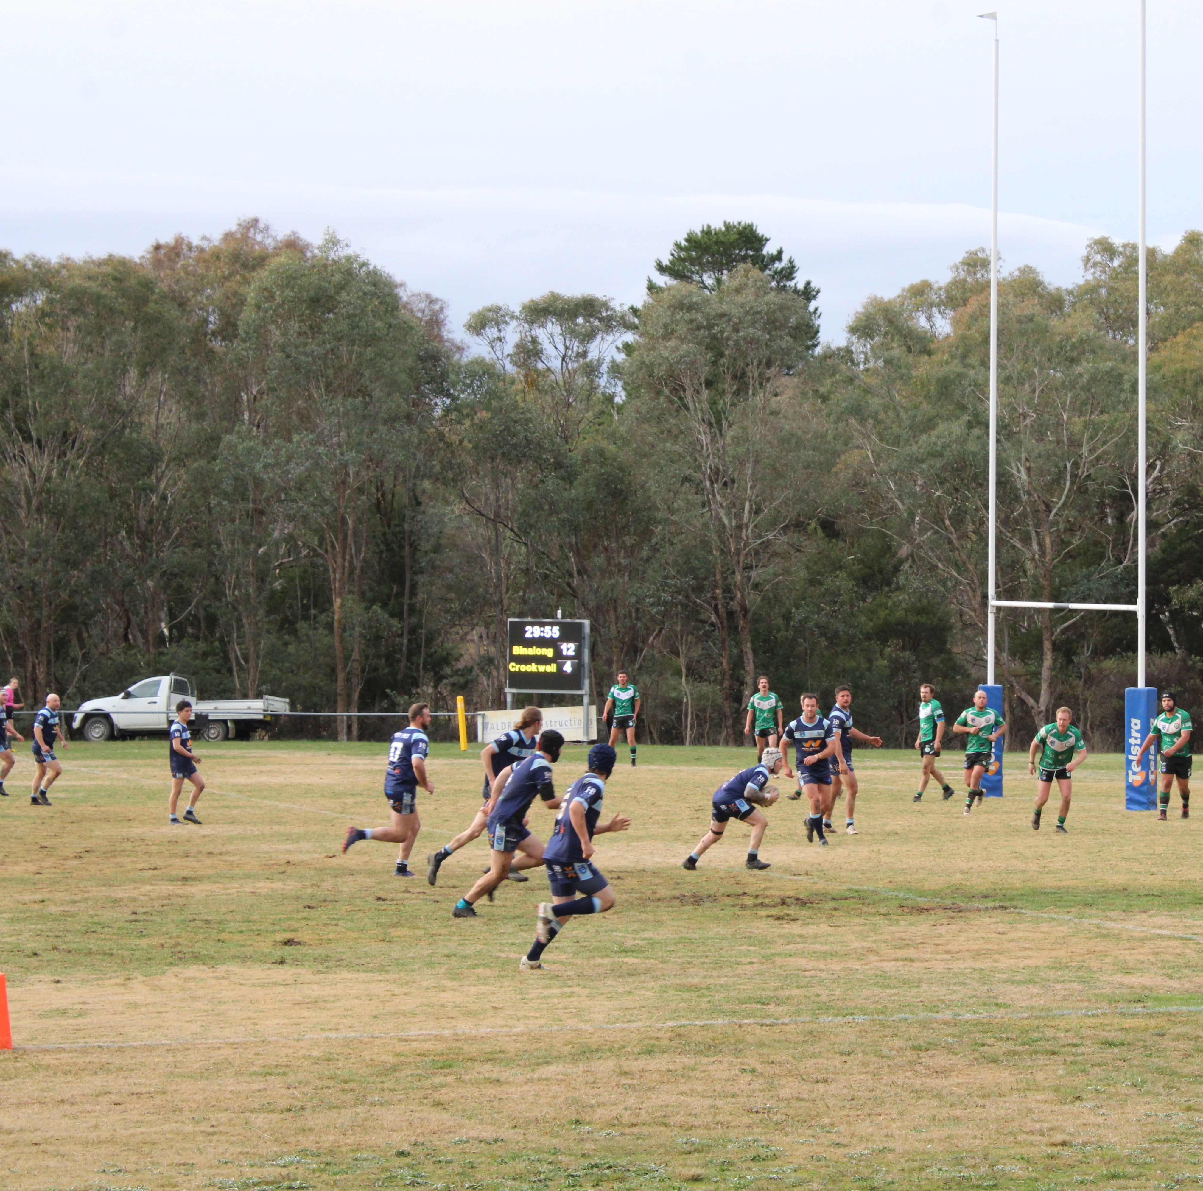
Long-Term Energy Service Agreement (LTESA)
Examples of how the community benefits immediately
Prior to operation $30-50,000/year for local projects
On operation
Community Enhancement Fund: $172.5K/year, Supplementary fund too
LGA / HTC regional investment commitments
Also….
Local supply chain commitments
Local steel products & components
Investment & innovation commitments

Slide 7
Community Engagement Update
Project Contact Points
General Information hotline (free call where you leave a messages and Alison will get back to you) | 1800 884 689
Email | info@coppabellawindfarm.com
Website | www.coppabellawindfarm.com
Paul’s direct phone number (Stakeholder Engagement Manager) | 0400 004 293
Alison’s direct phone number (Local Community Relations Officer) | 0401 472 691
Ben’s direct phone number (Development Manager) | 0400 882 095

Slide 8
Project Update

Slide 9
Project Update – key elements
    Progressing internal Goldwind approvals
  Firm Pricing for Construction Contracts / Civils Design
  Funding arrangements
Finalising Coppabella program
  civil, electrical, grid and turbine program components
    Planning Approvals (State, Federal, Crown):
  Satisfying pre-construction conditions and compliance planning activities
  Environment Protection Licence (for Construction Activities)
  Transgrid Addendum REF 2 for 99M Rebuild (incl. STATCOM) was approved 1 March 2024
    Grid Connection Agreement
  Connection Application was lodged Feb 2023
  Full Impact Assessment analysis has been successfully completed, report is pending
  Full submission package submitted & reviewed – final AEMO/TG acceptance pending
  Transgrid is progressing re-tender activities on grid works with selected contractors
  Connection schedule & costings to then be assessed
  Offer to Connect (Technical 5.4.3 a & b Letters) anticipated Jul 24, commercial to follow
    Land Agreements
  Transgrid access arrangements – connect to grid (finalising)
  Neighbour Agreements

Slide 10
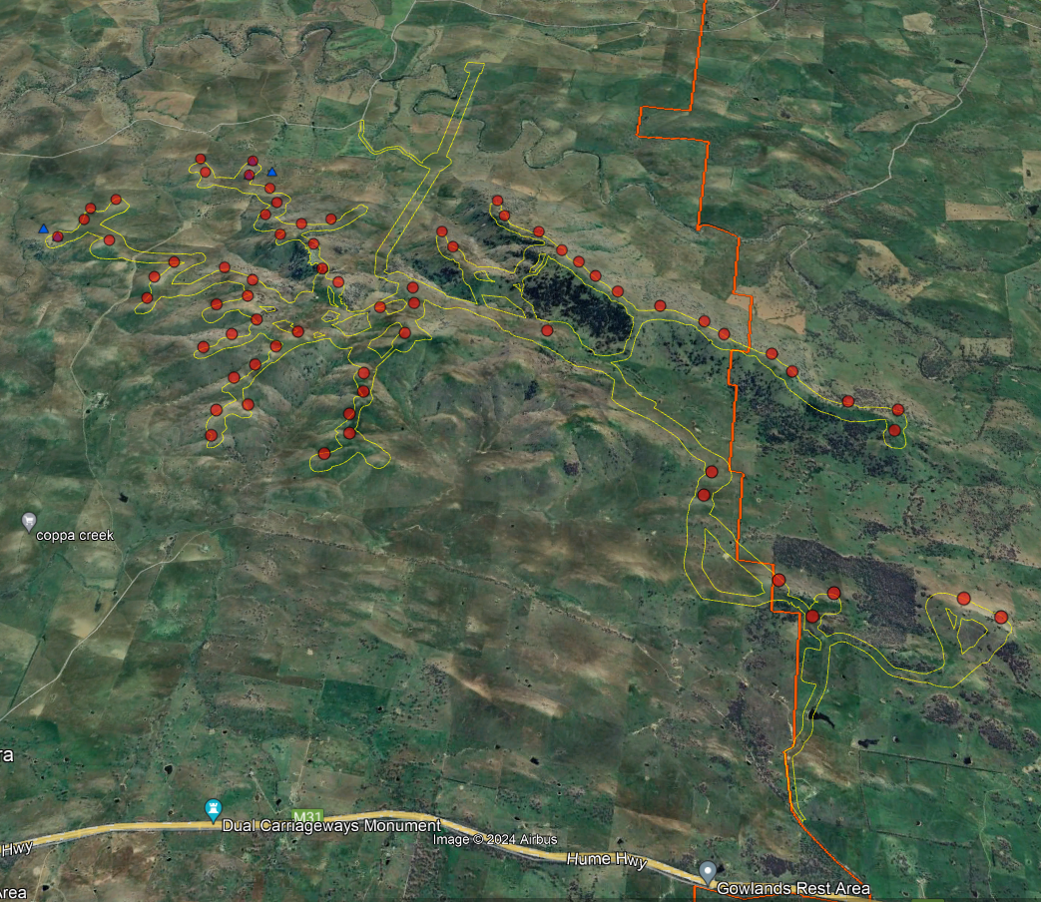
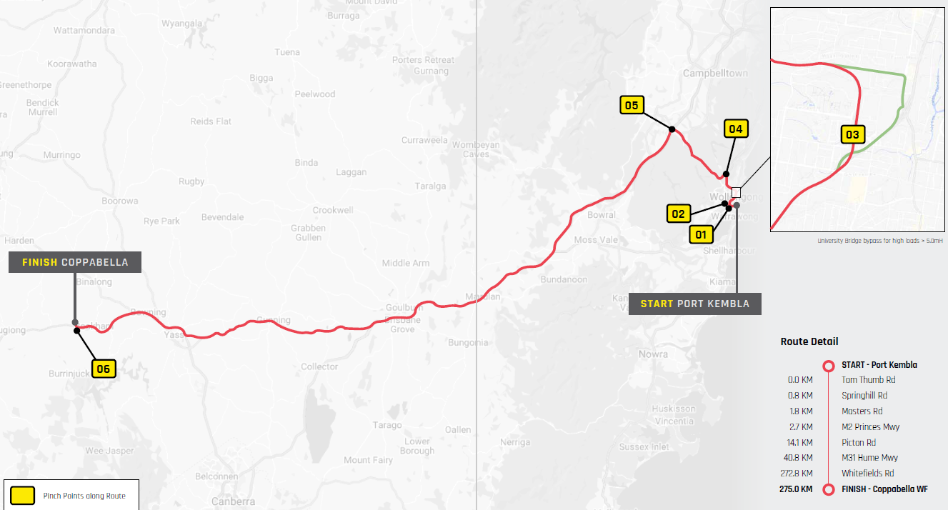
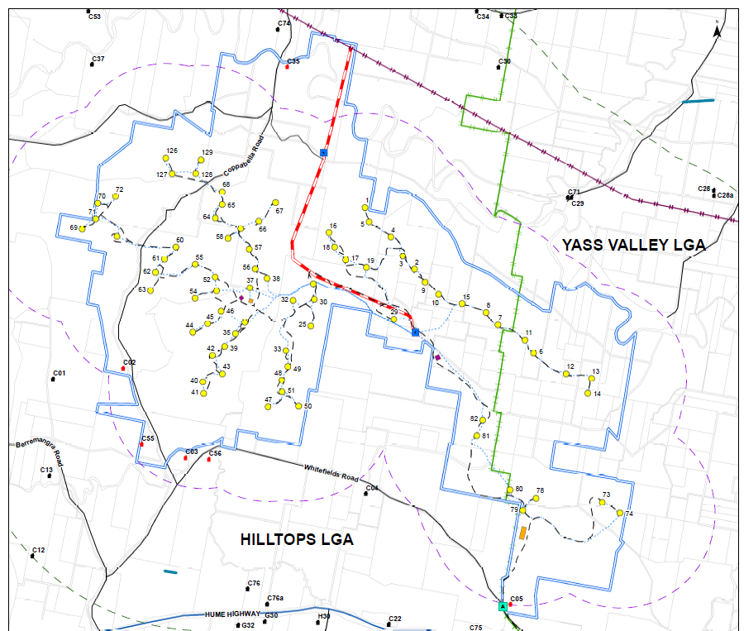
Coppabella Wind Turbine Layout
275 km from Port Kembla
Recap – scope of 30% Civils Design Screening
Hilltops Council
Yass Valley Council
75 WTG Approved

Slide 11

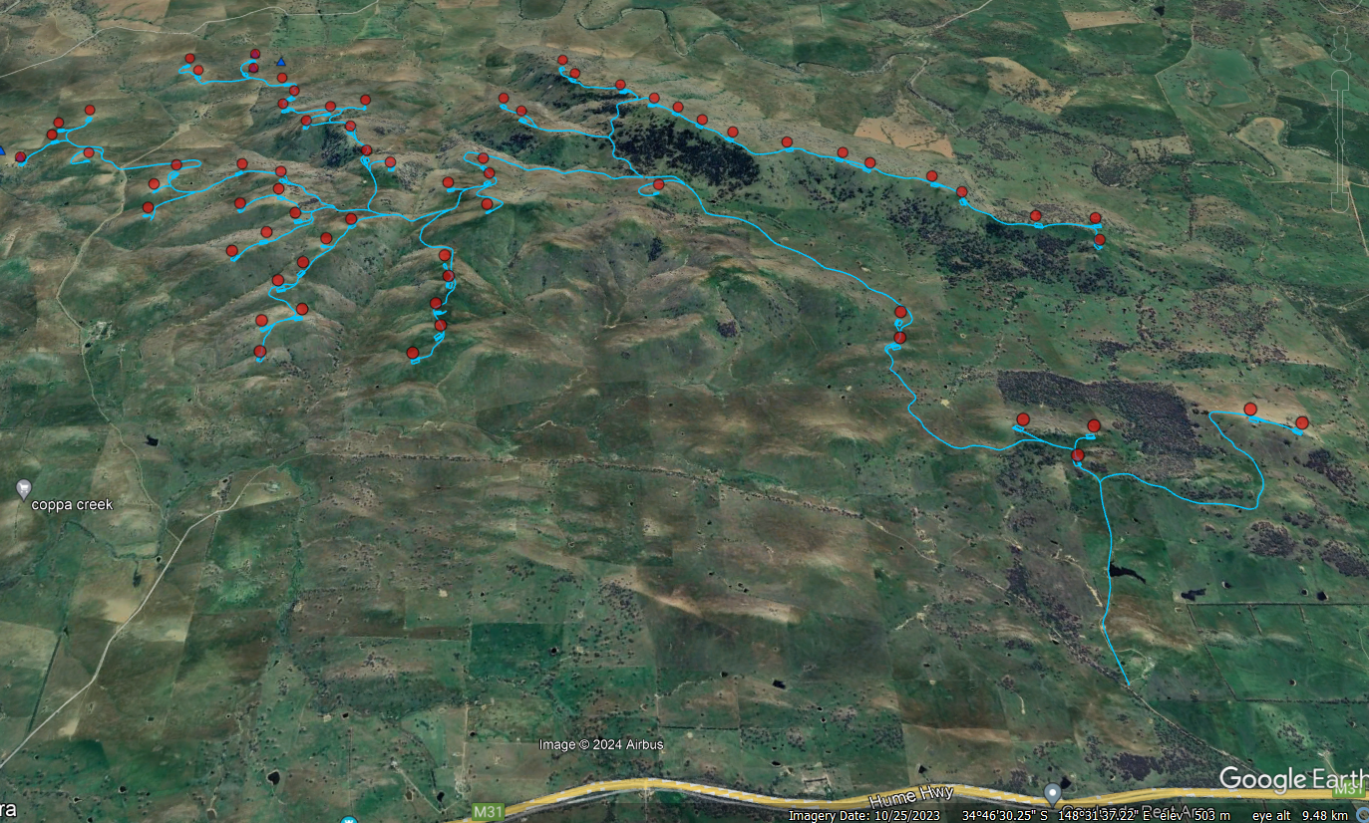
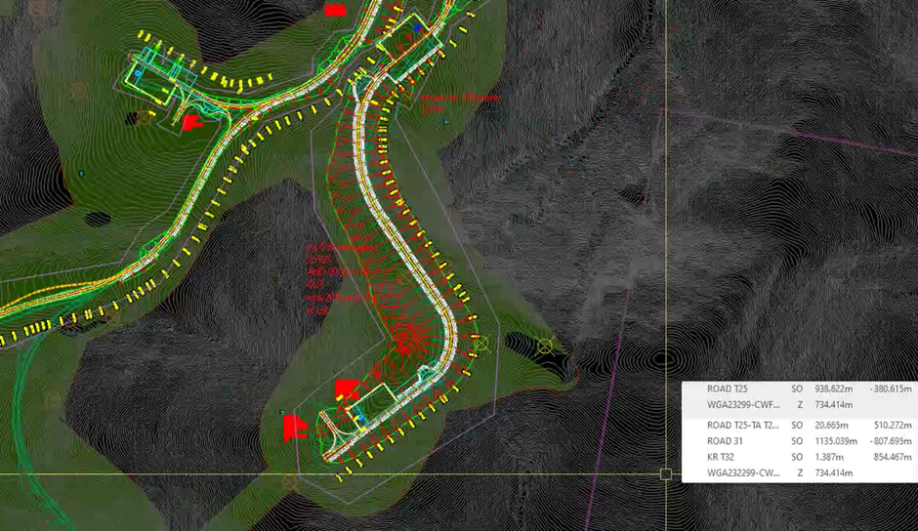
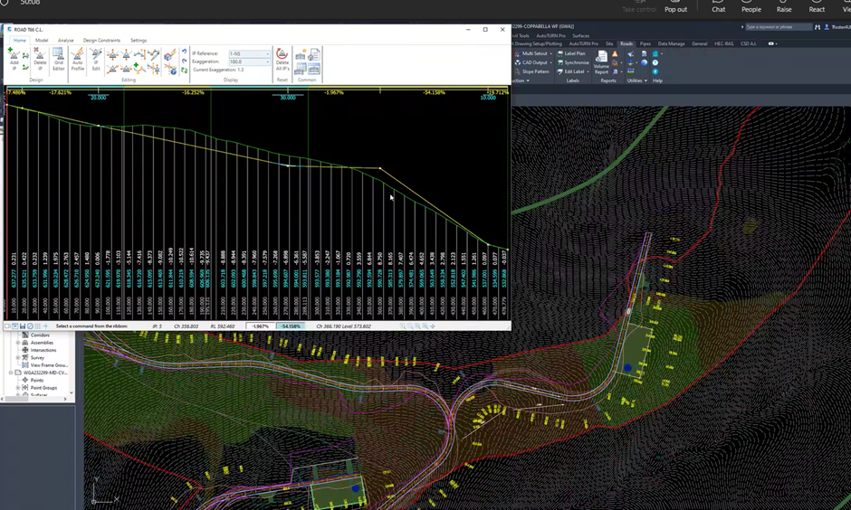
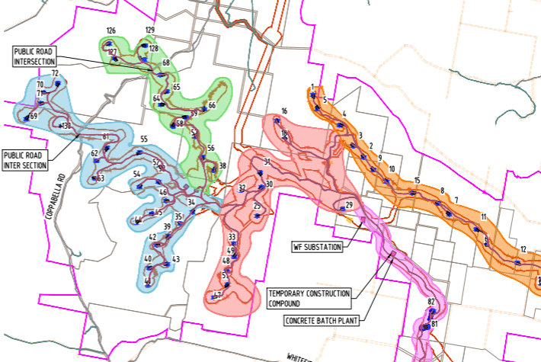
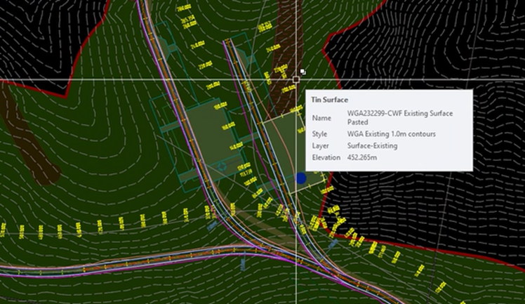
Coppabella Civils Design –1H24
Project has progressed civil design screening of all WTG installations
Purpose is to:
  Identify any problematic WTG installations now rather than at site - completed
  Optimise design to minimise ground impact activities – completed (30% Design)
  Support contractor selection – contractor in pricing
Process is to step through complex topography areas:
  Reduce need for earthworks – material reduction / options achieved, potential for further
  Reduce road gradients – reduced high % gradient road lengths
  De-risk construction activities - achieved

Slide 12
Project Timeline - 3Q24
Key Dates
Q3 2024
GW Approvals / Investment funding (active)
Planning
  Compliance / plans
Civils Design (Stage 1) - complete
BOP re-tenders – (active)
Grid Works 132kV
  Transgrid – Offer To Connect
Q4 2024
Initial Works
  Met mast deployment
  Public Roads Upgrade Works (on NTP)
Notice to Proceed (NTP)
  Electrical BOP
  Civils BOP
  Turbine Supply & Install
  Transgrid Grid Transmission works

Slide 13
Project Timeline
Project Activities
Indicative timeline, may change
Initial Works
Transmission Line Works
Transmission: Preliminary designs & procurement specifications
Offsite Road Upgrades
Site Calibration Met Masts
Geotech investigations
Substation Energisation
Civil Works
Site Establishment
Start of turbine access road construction including
Start turbine foundation and hardstand construction
Electrical Works
Site Establishment
Start cable trenching and installation
Start cable terminations and testing
Year 1
Year 2
Year 3
Turbine Deliveries and Installation
Turbine deliveries commence
Turbine installations commence
Turbine Testing and Commissioning
Start WT Commissioning
Full Operations

Slide 14
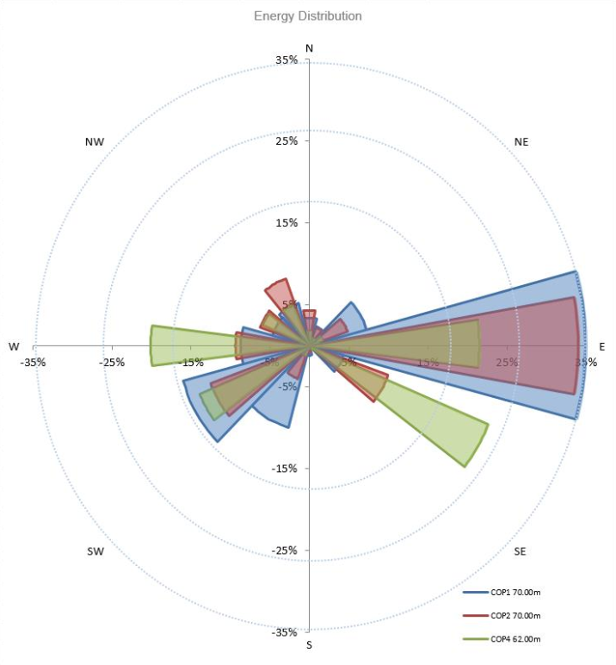
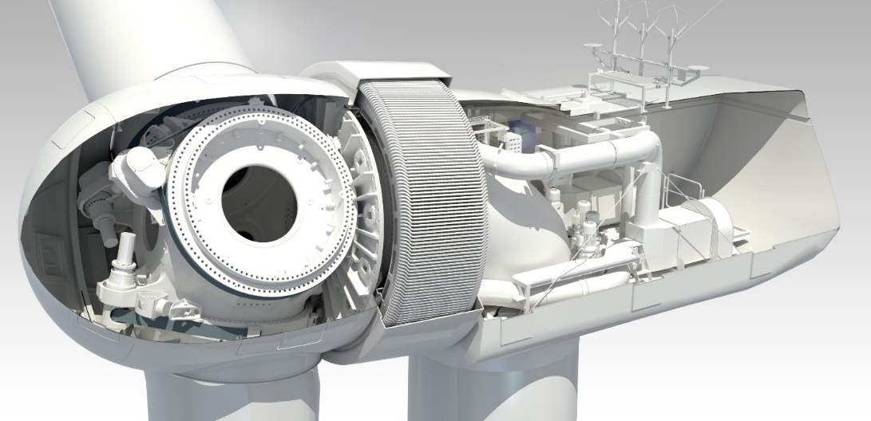
Energy Yield & Layout
Energy Assessment - Key Stats
7.5m/s (27 km/h):
  Ave. wind speed at hub height across the site
  6.5-8.5m/s across wind turbine locations
  Strong wind resource for NSW
GW4.2 Wind Turbine
The GW136/4.2MW is being proposed for the site:
  Permanent magnet direct drive design
  No high-speed gearbox
  High efficiency
  IEC Class IIA wind turbine
  100m hub height, 171m tip height
  LiDAR Assisted Control (LAC)

Slide 15
Planning Update

Slide 16
Planning Update
Ongoing Update and Finalisation of Project Documentation
Biodiversity Offsetting Requirements
  Vegetation remapping completed and agreed (Sch.3, C.19a) with BCD. Currently finalising the biodiversity offset credit requirements. Awaiting on BCD response to full GW RFI response (finalise Q324).
  Variation to Condition of Approvals
  Requirement to update EEC clearing limits to align with the completed vegetation remapping.
  Submitted December ‘23 and currently being assessed by DPE & DCCEEW (finalise Q324 pending resolution above)
  Biodiversity Management Plan (BMP)
  Updated BMP lodged December 2023 (with Regulators – finalise Q324)
  Other Management Plans
  Review previously approved management plans and update (where required)
  Bird Bat Management Plan
  Whitefields Roadside Vegetation Management and Landscaping Plan
  Progressing Offset arrangements
Environment Protection Licence (EPL)
  Application drafted. To be lodged prior to NTP.
  Other
  Whitefields Road – has been impact to Whitefields Road plantings in Dec 2023 due to Council road upgrades. Project investigative report prepared to document impact for DPHI & future council works.
  Council sprayed blackberry along Whitefields Rd – follow up spraying in Autumn
  Lodged Water Supply Works approvals for test bores. Resubmission for minor amendment.

Slide 17
Construction & Operations phases
– managing the asset

Slide 18
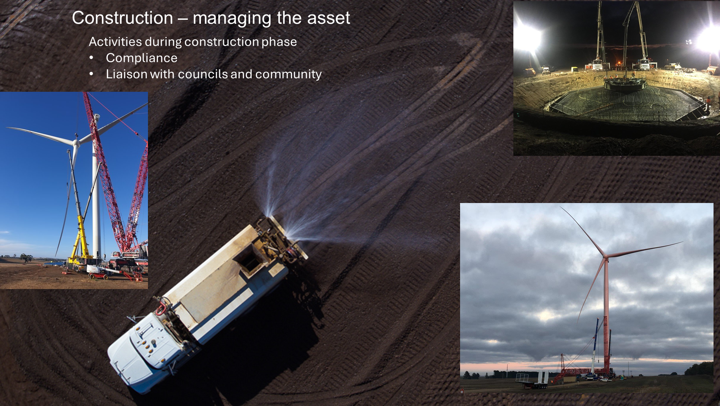
Construction phase – managing the asset

Slide 19
Q & A

Slide 20
Outstanding Items from CCC #19
None

Slide 21
Glossary
kV
kiloVolt – a thousand volts, a volt is a measure of electromotive force for power circuits
Lac
LiDAR assisted control
LiDAR
Light detection and ranging
LTESA
Long-Term Energy Service Agreement
NTP
Notice to Proceed
REF
Review of Environmental Factors
RFI
Request for Information – a document that details information, guidance and clarification needs required for specific aspects of a project.
STATCOM
Static Synchronous Compensator – a reactive power regulating device based on the voltage sourced converter (VSC) used to maintain AC system voltages and to enhance the stability of the AC system
TG
Transgrid
WT/WTG
Wind Turbine Generator
AEMO
Australian Energy Market Operator
BCD
Biodiversity Conservation Department
BOP
Balance of Plant
COD
Commercial Operation Date
DCCEEW
(Federal) Department of Climate Change, Energy, the Environment and Water
DPE / DPHI
The changing name of the NSW Department of Planning
(DPE – Department of Planning and Environment,
DPHI – Department of Planning, Housing and Infrastructure)
GW (A)
Goldwind (Australia)
IIA
Wind Class/Turbulence classification per IEC 61400
IEC
International Electroctechnical Commission

Slide 22
THANKYOU
GOLDWIND AUSTRALIA PTY LTD

